Slide 1

Alabama Veterans Museum
Presented by Phillip Owens and Nicholas Morgan
Final Presentation

Slide 2
The Project and Requested Changes
The Alabama Veterans Museum project consisted of a GUI front-end to an SQL database for deceased veterans created by a previous team from Athens State University.
The Museum Administration requested several additional items be added to the application.
A solution for automatically backing up the application’s SQL data was required.
Notification that data had been successfully saved was requested.
The ability to clear previous data from forms when starting a new record was also requested.
Problems with displaying the User Guide from the original project needed to be addressed

Slide 3
Solutions
Sprint 1 Goals
Creating a backup solution which could be used for both remote and local scheduled backups.
Altering the application to add the appropriate controls to the GUI for clearing the forms.
Adding feedback points to confirm that data was successfully saved .
Correcting broken links to the Application Users Guide.

Slide 4
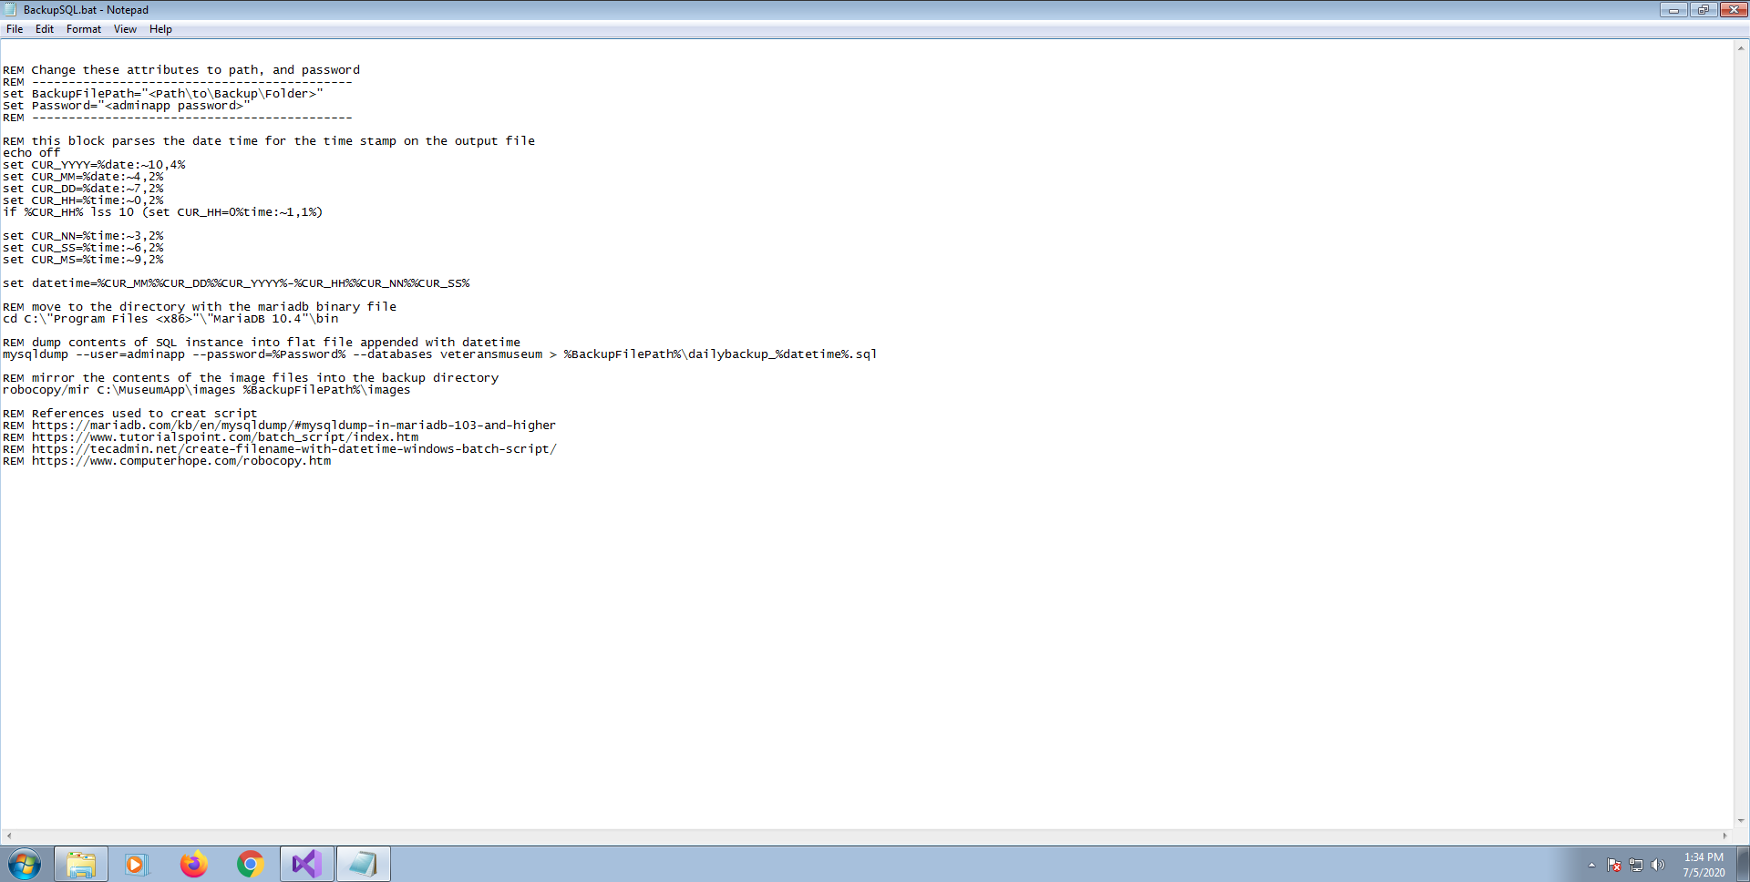
SQL Backup Solution

Slide 5
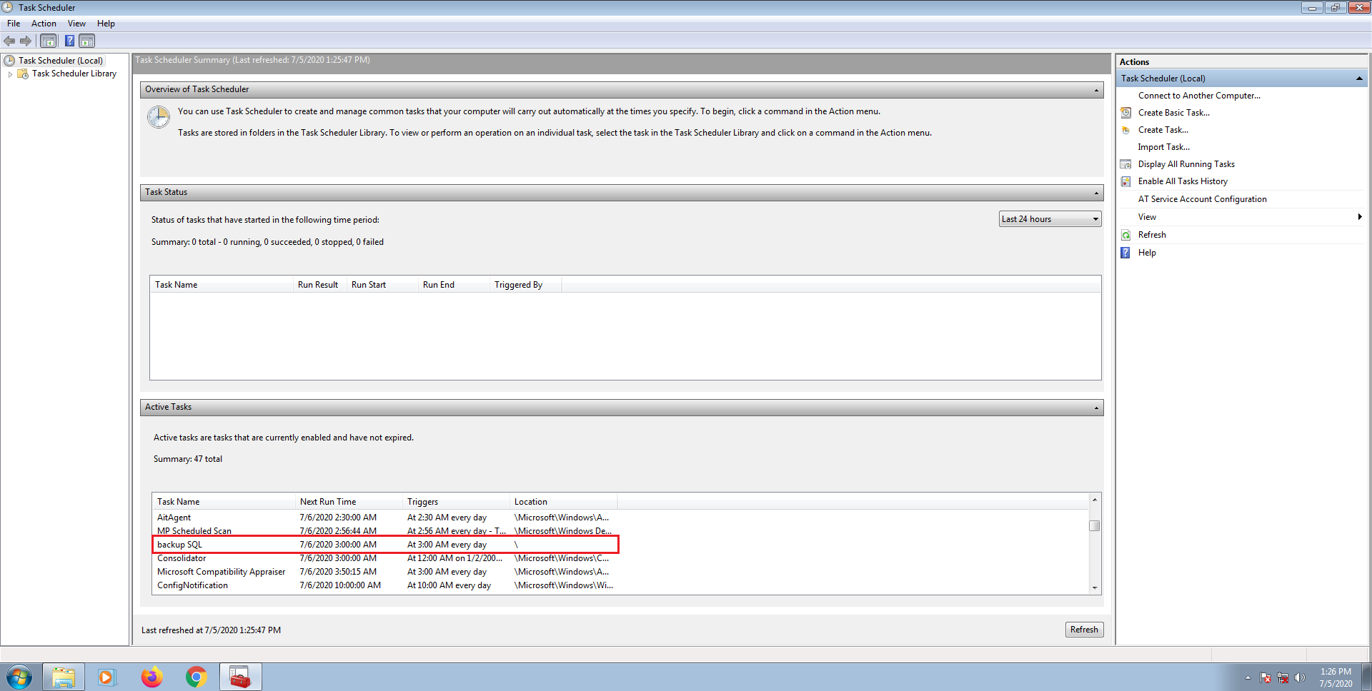
SQL Backup Solution

Slide 6
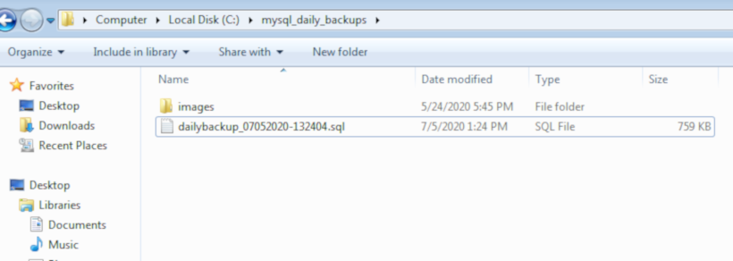
SQL Backup Solution

Slide 7
Application User Guide
The User Guide exists as a .pdf file.
It is installed to the disk by the installed batch file.
A browser shortcut is created on the desktop by the installer.
The shortcut opens the .pdf file using the systems internet browser.

Slide 8
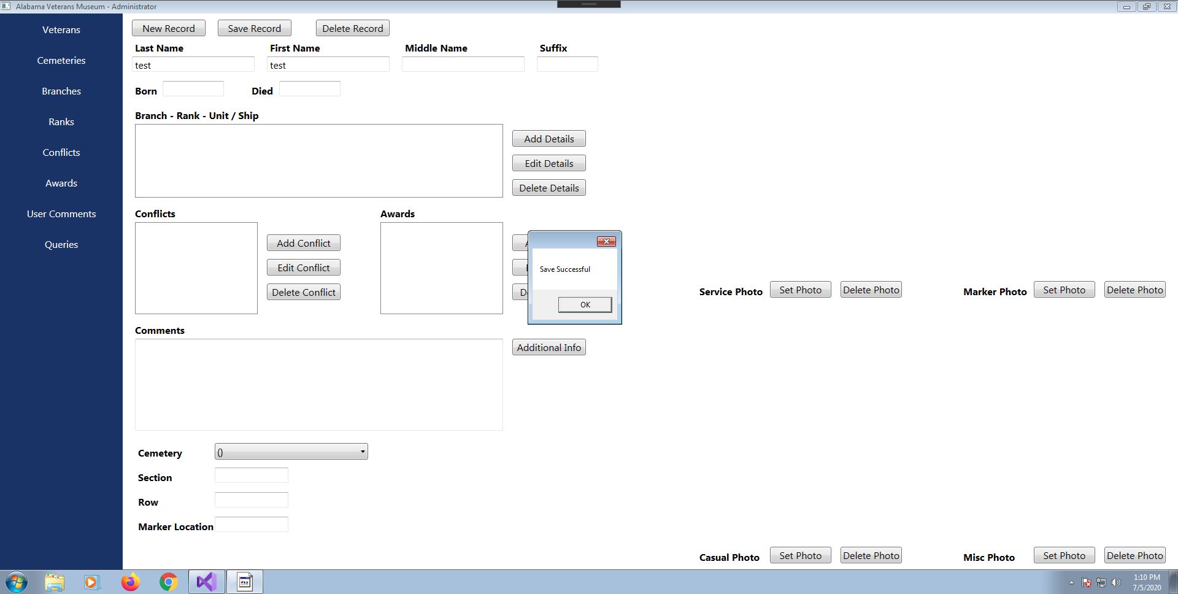
Save Notification

Slide 9
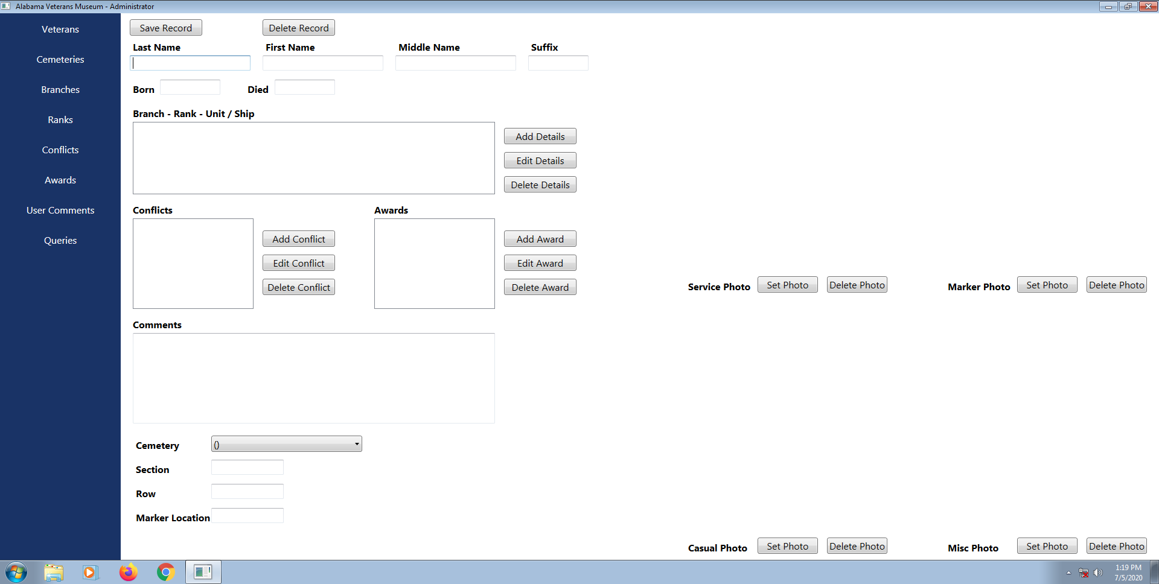
Clearing Forms
Existing GUI

Slide 10
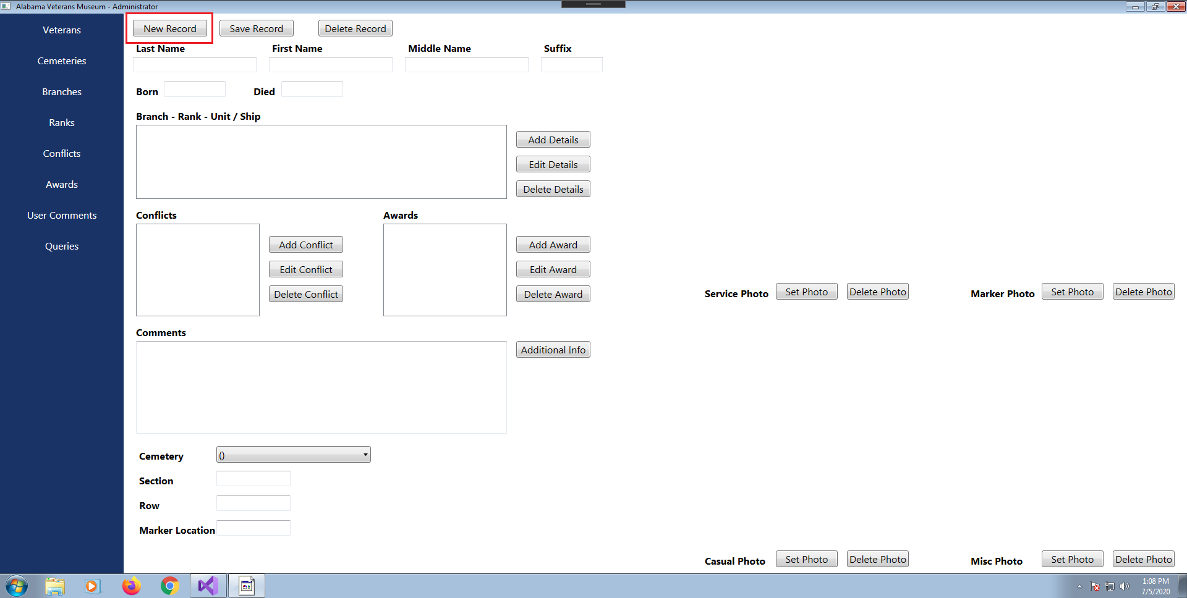
Clearing Forms
New GUI

Slide 11
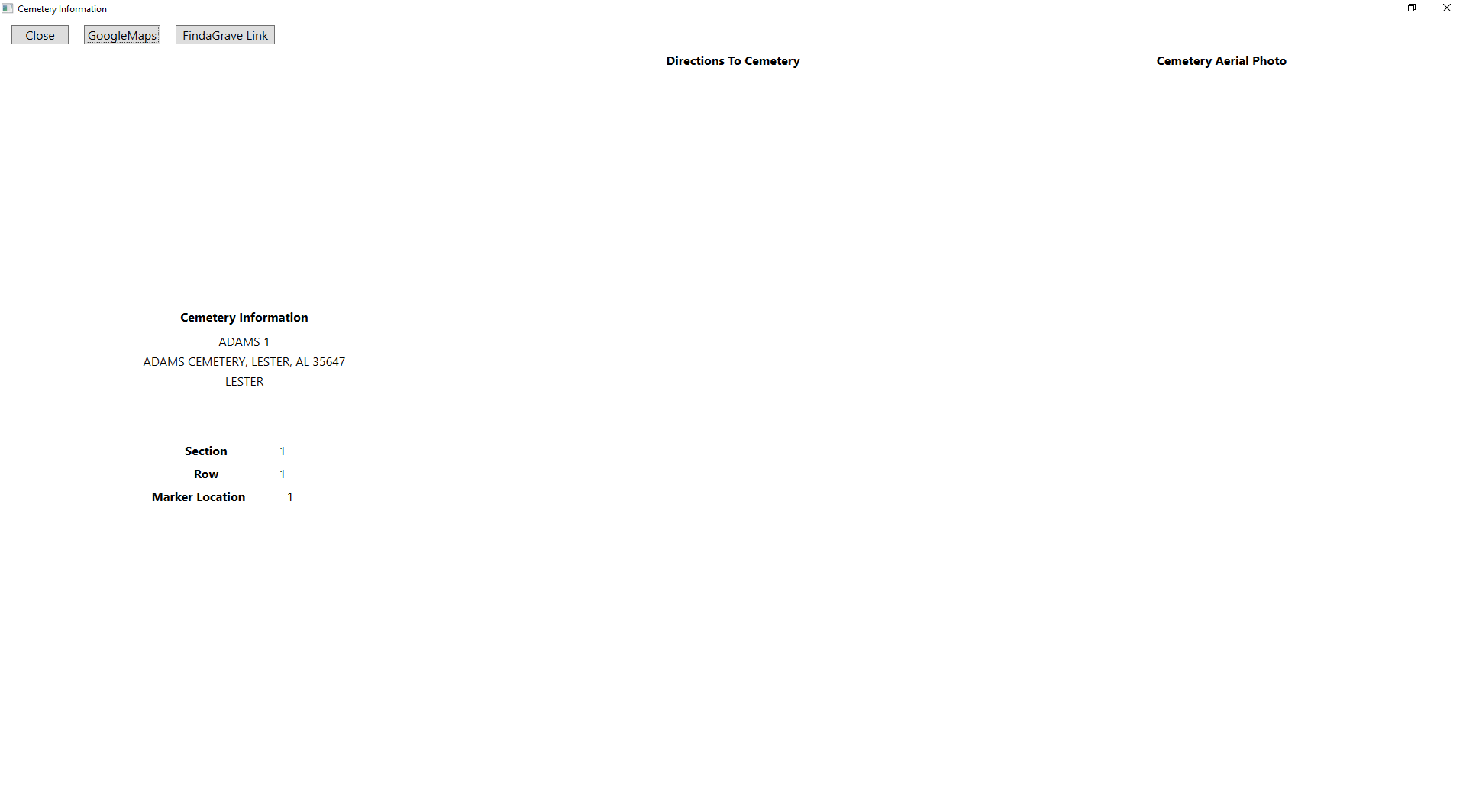
Google Maps

Slide 12
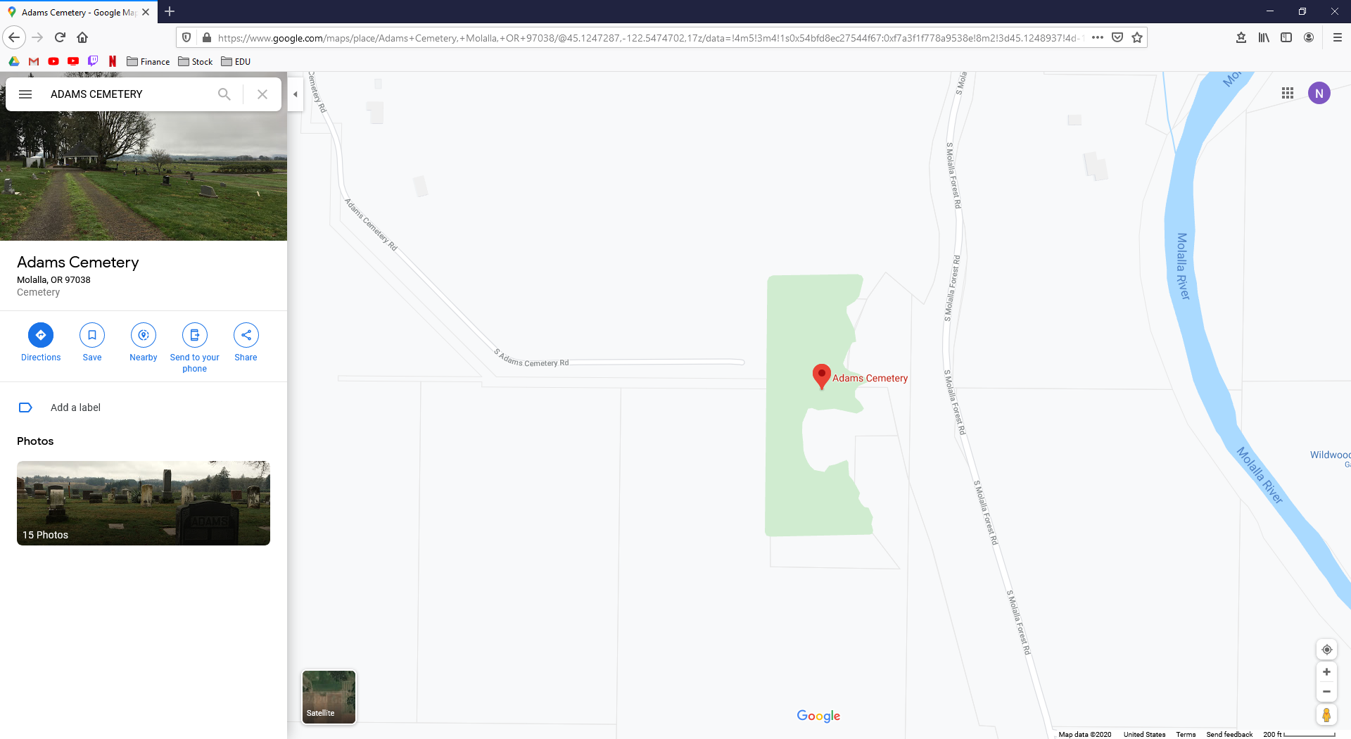
Google Maps

Slide 13
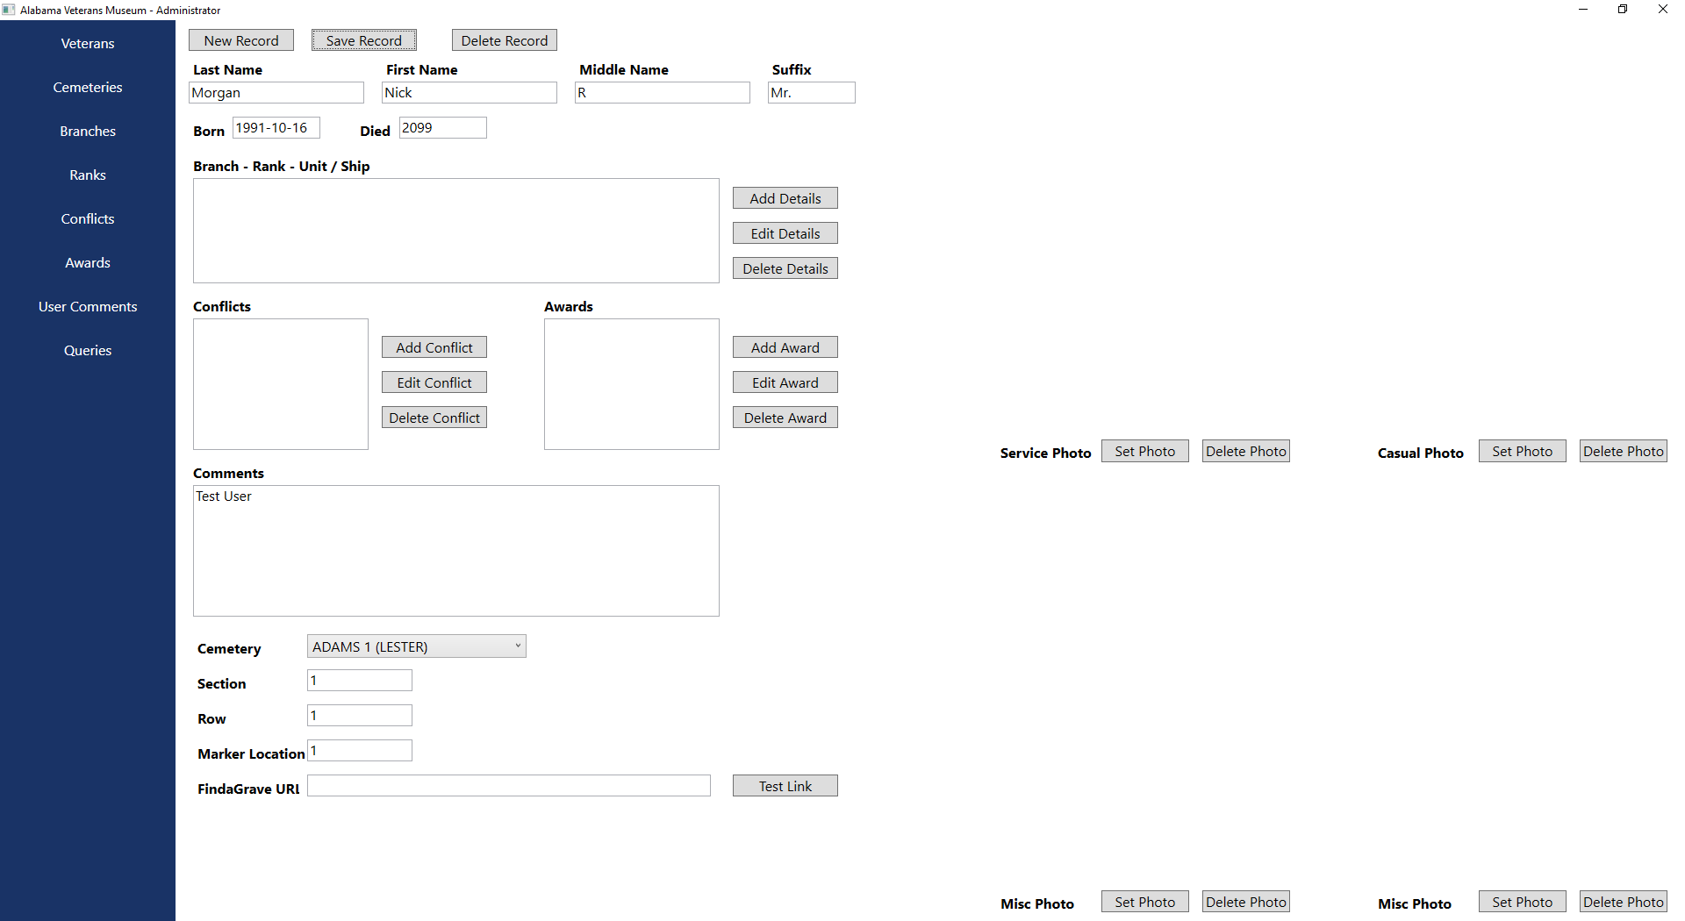
DOB/DOD Changes

Slide 14
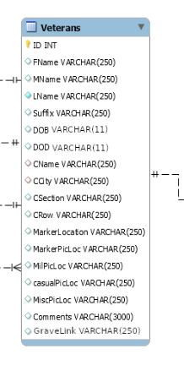
DOB/DOD ER Diagram

Slide 15

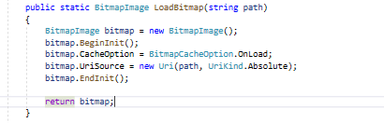
Upload Image Crash

Slide 16
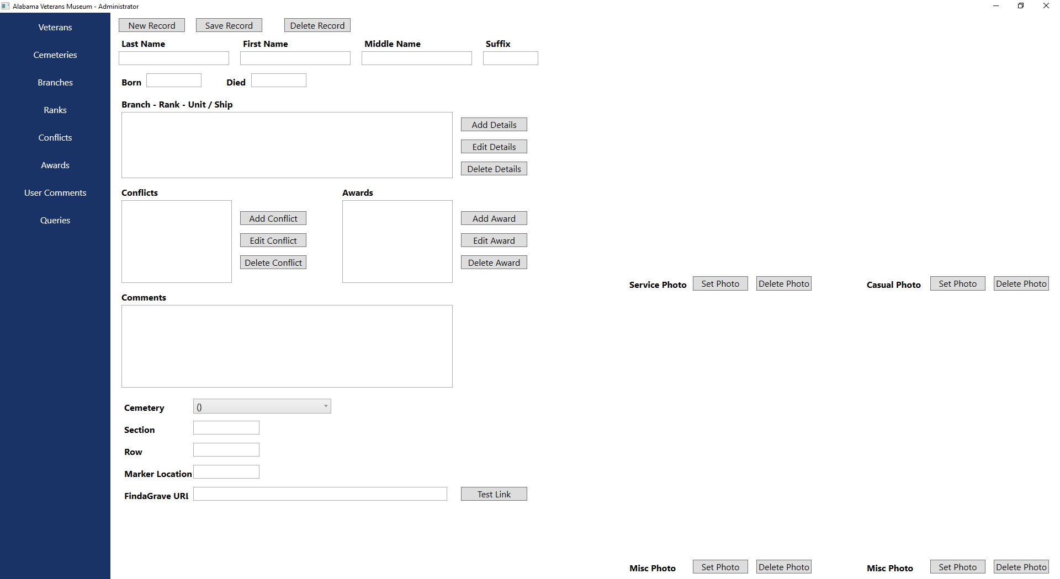
Find A Grave
Admin

Slide 17
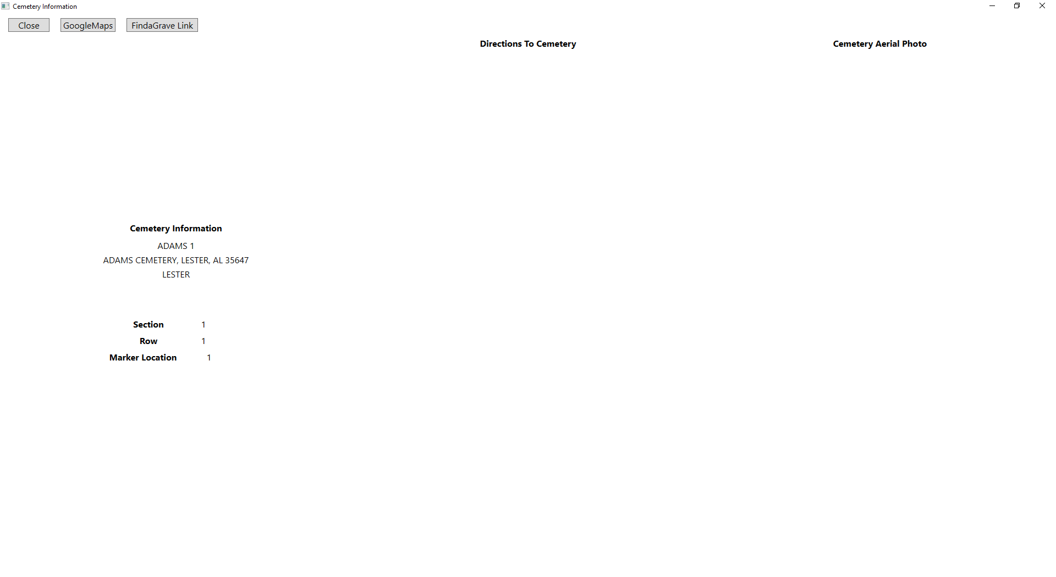
Find A Grave
Viewer

Slide 18
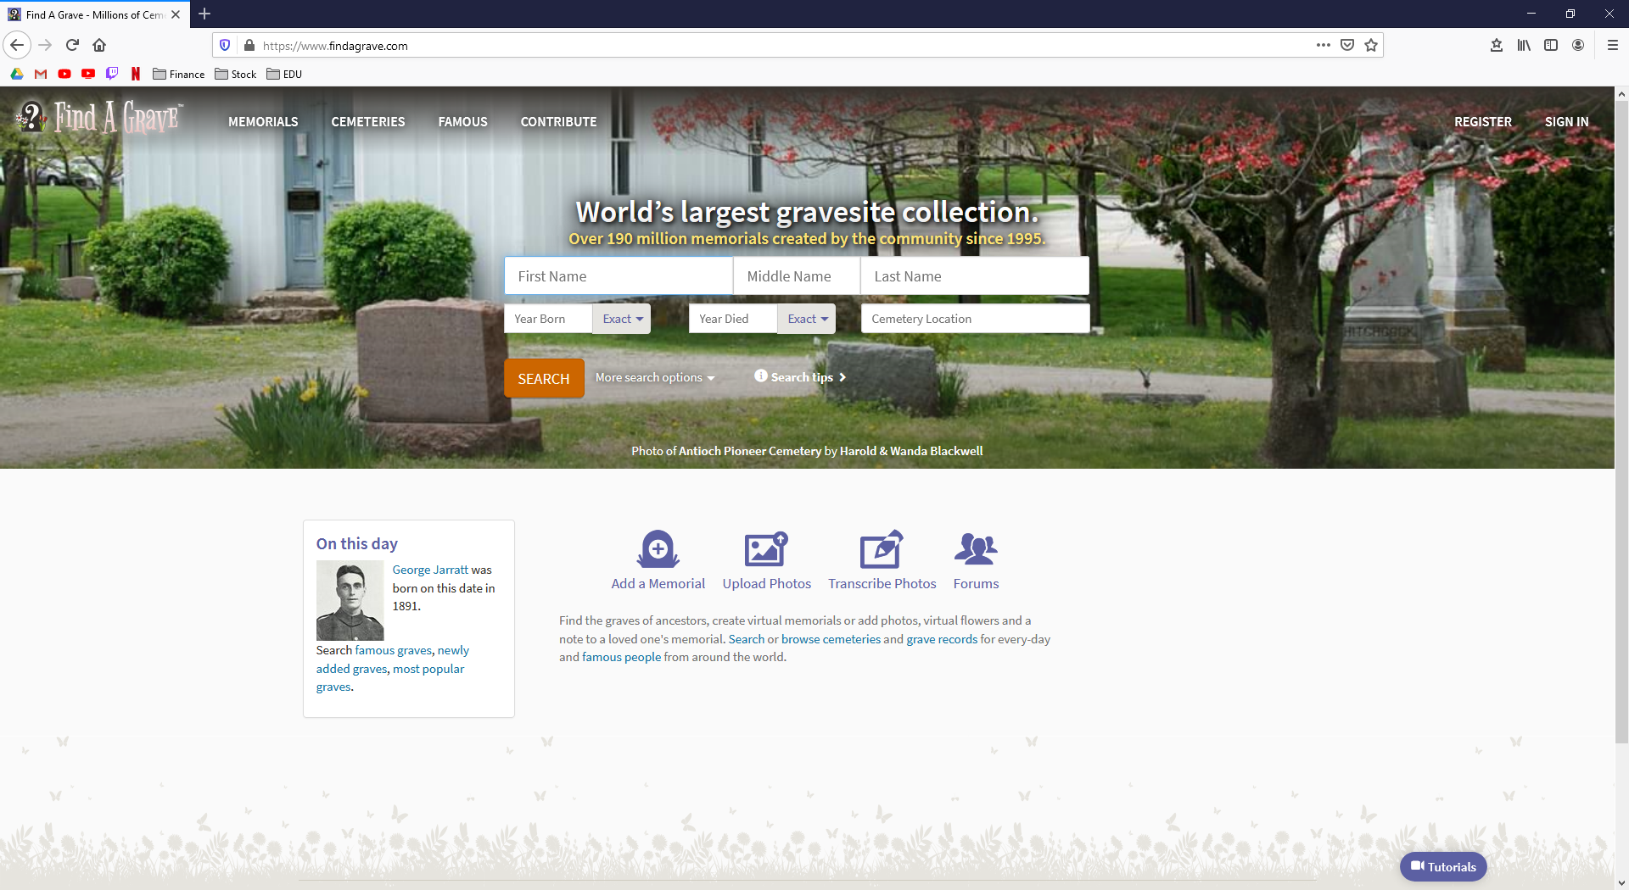
Find A Grave
Website

Slide 19
Thank You

